Slide 1
Falcon: Live Reconfiguration for Stateful Stream Processing on the Edge
Pritish Mishra, Nelson Bore, Brian Ramprasad, Myles Thiessen, Moshe Gabel, Alexandre da Silva Veith, Oana Balmau, Eyal de Lara

Slide 2
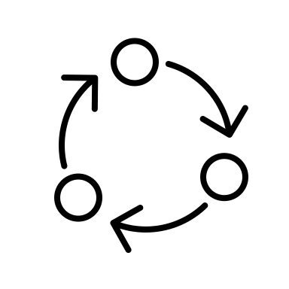
What Is Stream Processing?
Analytics
Applications
Data Streams
Continuous Data Processing
Outputs

Slide 3
Stream Processing Is Popular
Real Time Analysis
Optimize search rankings in real time
Process and analyze streaming data
Real-time monitoring
Popular Stream Processing Frameworks
Organizations using these frameworks¹
1. https://flink.apache.org/what-is-flink/powered-by/

Slide 4
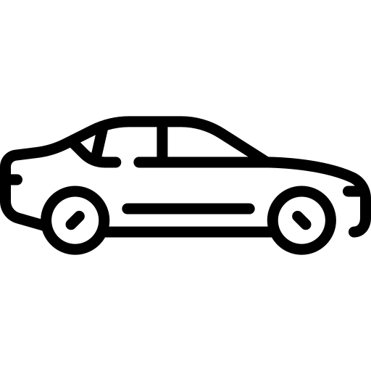
Stateful Stream Processing - Basics
C1
AGG
Motion-Activated Camera 1 (Producer / Source)
CRL
Control
C1
Count
Aggregator Operator
Traffic Control
Operator
Consumer / Sink

Slide 5
Stateful Stream Processing - State
C1
3
1
2
13
12
5
4
6
15
17
16
19
7
9
8
11
10
20
18
14
Motion-Activated Camera 1 (Producer / Source)
C1
AGG
Count
CRL
Control
C1
Aggregator Operator
Traffic Control
Operator
Consumer / Sink

Slide 6
Stateful Stream Processing - Windows
Time-Based Window
C1
C1
C1
C1
8:04
8:03
8:02
8:01
3
1
2
13
C1
12
5
4
6
15
17
16
19
7
9
8
11
10
20
18
C1
14
Motion-Activated Camera 1 (Producer / Source)
AGG
Count
CRL
Control
C1
Aggregator Operator
Traffic Control
Operator
Consumer / Sink

Slide 7
Region
C1
C2
AGG0
CRL1
Cloud Datacenter
C3
C4
C5
C6
Street 1
Street 2
Street 3
Latency and bottlenecks
Internet
C1
C2
C3
C4
C5
C6
C1
C2
C3
C4
C5
C6

Slide 8
Region
C1
C2
AGG0
CRL1
Cloud Datacenter
Size of data being transferred to the cloud is low due to low user demand
C3
C4
C5
C6
Street1
Street2
Street3
Edge Datacenter(s)
C1
C2
C3
C4
C5
C6
C1
C2
C3
C4
C5
C6

Slide 9
Region
C1
C2
AGG0
CRL1
Cloud Datacenter
C3
C4
C5
C6
Size of data being transferred to the cloud is high due to high user demand
Street1
Street2
Street3
Edge Datacenter(s)
C5
C1
C5
C6
C1
C2
C5
C1
C2
C3
C4
C5
C6
C1
C2
C3
C4
C5
C6

Slide 10
Conclusion: Reconfiguration of a running application needs to be done frequently to adjust to varying user demand.
Region
C1
C2
AGG0
CRL1
Cloud Datacenter
C3
C4
Reduces the amount of data being transferred to the cloud
C5
C6
Street1
Street2
C5:4 C6:2
Street3
C1:3 C2:2
AGG1
AGG3
Edge Datacenter(s)
C5
C1
C5
C6
C1
C2
C5
C1
C2
C5
C6
C1
C2
C3
C4
C5
C6

Slide 11
Region
AGG0
CRL1
Cloud Datacenter
Street1
Street2
Street3
C1
AGG1
C4
AGG3
Edge Datacenter(s)
C2
C5
C3
Conclusion: Frequent reconfiguration is also required to adjust to moving data sources.
C1
C2
C3
C4
C5

Slide 12
Need For Frequent Adaptation
Edge resources are more expensive:
Use resources only when needed
Data sources may move:
State may need to be moved between replicas

Slide 13
Existing Systems
Full-restart
Stops the entire application, performs reconfiguration and then restarts the application
Systems: Flink
Partial-pause
Hot backups
Stops only the affected operators and Use fine-grained transfer and on-demand fetch to spread the impact of application disruption
Systems: Trisk, Meces
State is replicated periodically to all possible locations where reconfiguration could occur
Systems: Rhino

Slide 14
Full-restart systems
Region
AGG0
CRL1
Cloud Datacenter
Street1
Street2
Street3
AGG1
AGG3
Edge Datacenter(s)
C2
C2
Systems like Apache Flink result in more delays

Slide 15
Partial-pause systems
Region
AGG0
CRL1
Cloud Datacenter
Street1
Street2
Street3
C1
AGG1
AGG3
Edge Datacenter(s)
C2
C3
C1
C2
C3
Systems like Trisk and Meces incurs disruption delays with inefficient state management.

Slide 16
Hot backup systems
Region
C2
AGG0
CRL1
Cloud Datacenter
Street1
Street2
Street3
AGG1
AGG3
C2
Edge Datacenter(s)
C2
C2
Hot backups systems like Rhino still incur disruption delays.

Slide 17
Existing Solutions Fail For The Edge-Cloud!
Reconfiguration has significant stoppage time.
Apache Flink
Inefficient state management.
Meces
Rhino
Trisk
Do not handle source mobility.
Falcon System: seamless reconfiguration, minimal stoppage time, state and mobility support

Slide 18
Challenges Of Performing Reconfiguration
Global coordination
Long state transfer time
State correctness guarantees
In-order and Exactly-once Tuple Processing
Late Binding
Duplicate processing of tuples during reconfiguration
The source processes while the destination transfers and replays tuples to sync its state
Emit filter and Marker-based synchronization

Slide 19
Region
Node | Keys
A0 | *
A1 | C1
A3
Cloud Datacenter
A0
Street1
Street2
Street3
1
Edge Datacenter(s)
A1
A3
1
1
C1

Slide 20
Mobility Detected
Region
Node | Keys
A0 | *
A1 | C1
A3
Migrate C1 state from A1 to A0
Cloud Datacenter
A0
2
Street1
Street2
Street3
1
Edge Datacenter(s)
A1
A3
1
2
C1

Slide 21
Mobility Detected
Region
2
Node | Keys
A0 | *, C1
A1 | -
A3 | -
Migrate C1 state from A1 to A0
Cloud Datacenter
A0
2
Street1
Street2
Street3
Edge Datacenter(s)
A1
A3
2
1
3
C1

Slide 22
Region
Mobility threshold
3
Node | Keys
A0 | *, C1
A1 | -
A3 | -
Cloud Datacenter
A0
3
2
Street1
Street2
Street3
Edge Datacenter(s)
A1
A3
2
1
C1

Slide 23
Region
3
Node | Keys
A0 | *, C1
A1
A3
Cloud Datacenter
A0
3
2
Street1
Street2
Street3
Edge Datacenter(s)
A1
A3
2
1
4
C1

Slide 24
Wait threshold exceeded
Region
4
Node | Keys
A0 | *, C1
A1
A3
Cloud Datacenter
Migrate C1 from A0 to A3
A0
4
3
2
Street1
Street2
Street3
Edge Datacenter(s)
A1
A3
2
1
5
5
C1

Slide 25
Wait threshold exceeded
Region
Node | Keys
A0 | *
A1 | -
A3 | C1
Cloud Datacenter
Migrate C1 from A0 to A3
A0
3
2
Street1
Street2
Street3
5
Edge Datacenter(s)
A1
A3
2
1
6
C1

Slide 26
Car C1 moves
Street 1 to 2
Car C1 moves
Street 2 to 3
200
150
P99 Latency (ms)
100
50
State Migration from Street 1 Node to Cloud
State Migration from Cloud to Street 3 Node
0
0
5
10
15
20
Time (s)
Car (C1) moves from Street 1 Edge Node to Street 3 Edge Node

Slide 27
Evaluation Baselines
Full-restart
Stops the entire application, performs reconfiguration and then restarts the application
Systems: Flink
Partial-pause
Hot backups
Stops only the affected operators and Use fine-grained transfer and on-demand fetch to spread the impact of application disruption
Systems: Trisk, Meces
State is replicated periodically to all possible locations where reconfiguration could occur
Systems: Rhino (Falcon-HB)

Slide 28
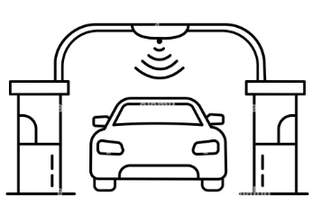
Benchmark Apps
Traffic Monitoring
Detects speeding vehicles using a running average Allows for easy control of number of keys, state size
Toll Notification
Smart toll computation and real-time accident detection # Road Segments - 101 # Cars (Keys) – 124K Uses event and count-based sliding windows

Slide 29
Disruption Duration

Slide 30
Peak Latency Jitter

Slide 31
Summary & Conclusions
Falcon minimizes reconfiguration disruption with live key migration.
Cuts interruption time to 40-45 ms, far below existing frameworks.
Guarantees in-order, exactly-once processing and mobility awareness.
More in the paper:
Baselines, results and protocol details!
Download the paper
pritish@cs.toronto.edu,
nelson.bore@mail.mcgill.ca
https://github.com/delara/falcon

