Slide 1
CloudPath: A Multi-Tier Cloud Computing Framework
Seyed Hossein Mortazavi, Mohammad Salehe, Carolina S. Gomes, Eyal de Lara

Slide 2
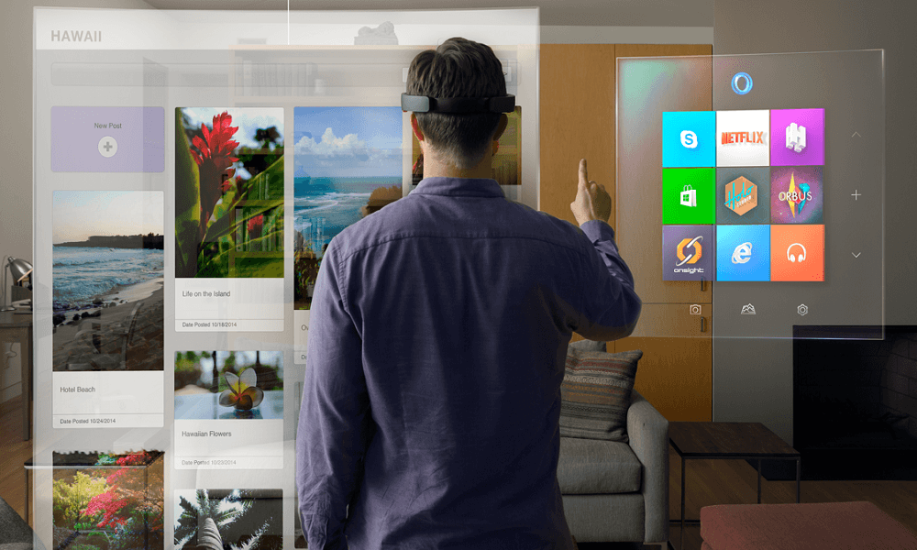
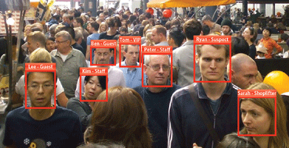
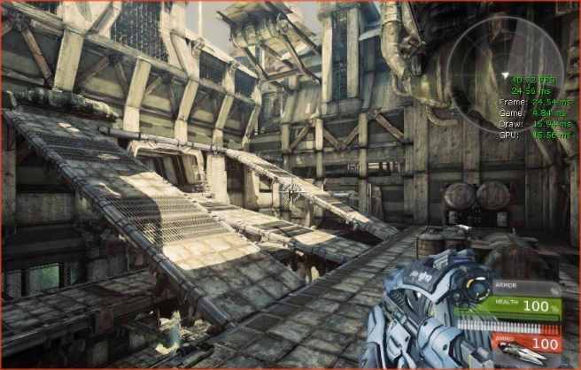
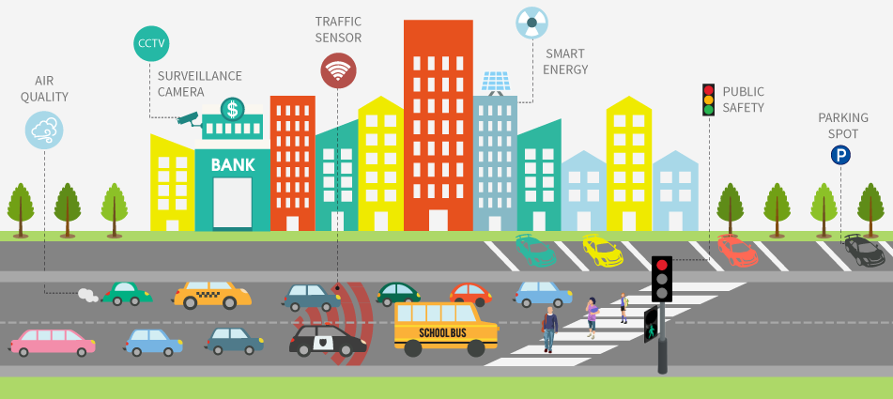
Next Generation Mobile Apps
Next generation applications require lower latencies, better response time
Virtual reality, safety-critical applications, smart cities, etc.
They need high bandwidth
Internet of Things(IoT) devices, wearable devices, Pervasive vision
Other requirements: mobility, scalability, processing application data

Slide 3
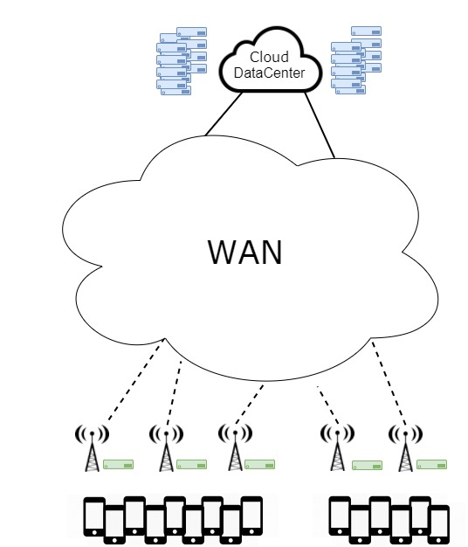
Edge Computing
Notes:
Cloud computing is a model for enabling ubiquitous, convenient, on-demand network access to a shared pool of configurable computing resources (e.g., networks, servers, storage, applications, and services) that can be rapidly provisioned and released with minimal management effort or service provider interaction.

Slide 4
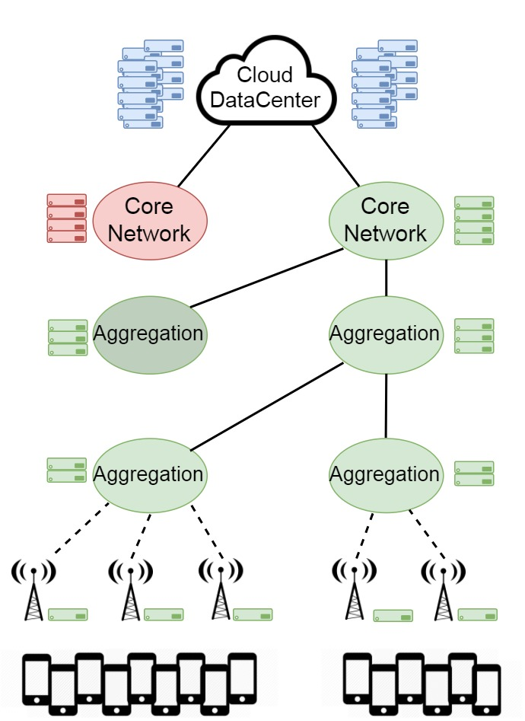
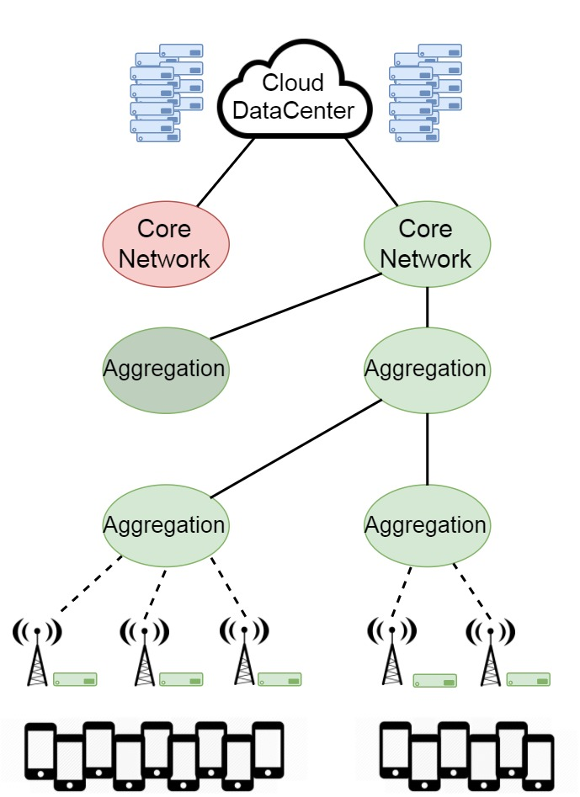
Edge Computing …
Notes:
Cloud computing is a model for enabling ubiquitous, convenient, on-demand network access to a shared pool of configurable computing resources (e.g., networks, servers, storage, applications, and services) that can be rapidly provisioned and released with minimal management effort or service provider interaction.

Slide 5
Path Computing
Multi-tier cloud paradigm that supports processing and storage on a progression of datacenters deployed over the geographic span of a network.
Notes:
Cloud computing is a model for enabling ubiquitous, convenient, on-demand network access to a shared pool of configurable computing resources (e.g., networks, servers, storage, applications, and services) that can be rapidly provisioned and released with minimal management effort or service provider interaction.

Slide 6
Benefits
Cache and aggregate data and process information at different layers
Optimize component placement based on:
Latency
HW availability
Cost
Geographic locality
Size of served population

Slide 7
Challenges
How to partition server functionality?
Most data centers are small
Applications need to be deployed on demand
Data needs to be replicated on demand

Slide 8
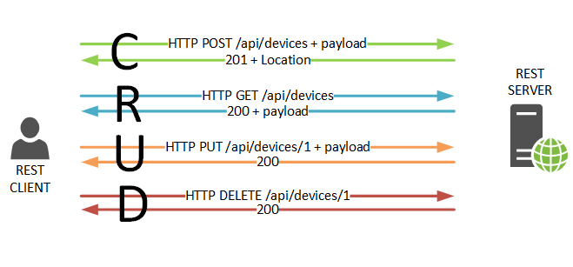
Modern Web Services/Applications
Collection of independent stateless handlers
REST
Scalability
Fault tolerance

Slide 9
Modern Web Services/Applications
Collection of independent stateless handlers
REST
Scalability
Fault tolerance
Key Enabler: Shared storage

Slide 10
Approach
Provide a distributed storage system
Provide a common runtime on all cloud nodes
Write server as a collection of short stateless event handlers
Label event handlers with performance requirements
Replicate application code and data on-demand
anywhere
10ms
100 ms
20 ms

Slide 11
Benefits
Familiar programming model
Explicit separation of code and data
Event handler are small
Implications
Easy to dynamically deploy
No need to migrate execution
Just start new function/event at new location

Slide 12
CloudPath
Path Computing prototype
3rd party applications
Datacenters (nodes) organized in a tree topology
Separation between application code and data
Developers: organize applications as collection of stateless functions
CloudPath: on-demand replication

Slide 13
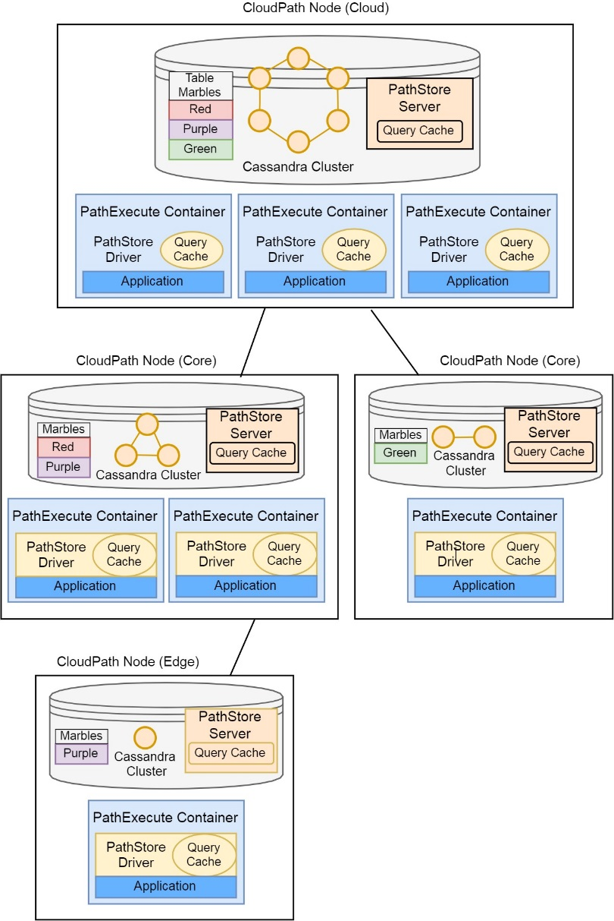
CloudPath
Data storage → PathStore
Execution environment → PathExecute
Deployment → PathDeploy
Routing → PathRoute

Slide 14
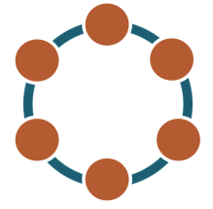
PathStore Design
Common data storage layer
Hierarchy of object stores
Store at the root of the hierarchy is persistent
All others, act as temporary partial replicas
Data replicated on-demand
All reads and writes executed against local replica
Modification propagate in the background
Cloud
Core 1
Core 2
Edge 1
Edge 2
Edge 3

Slide 15
PathStore Implementation
Based on Cassandra
Each node runs an independent Cassandra ring
PathStore copies data between rings
Row-level replication
CQL based interface
Consistency model
Within node: strong consistency
Across nodes: eventual consistency
Cloud
Core 1
Core 2
Edge 1
Edge 2
Edge 3

Slide 16
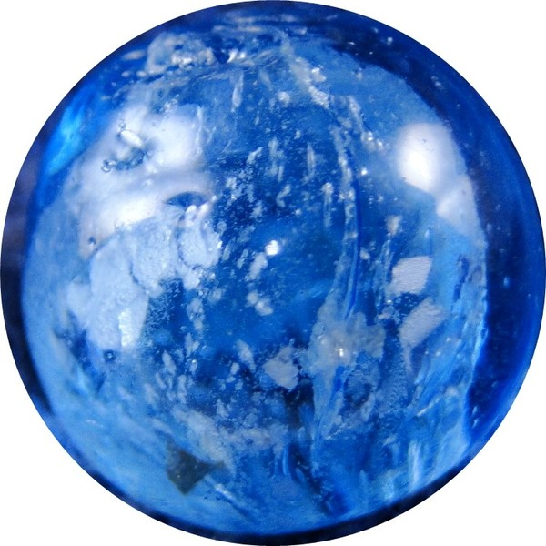
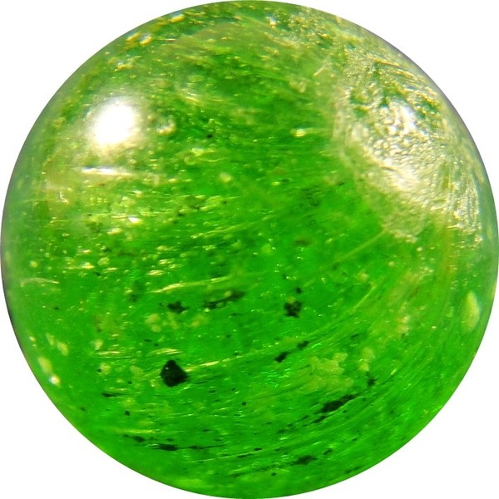
PathStore
Cloud
Marbels Table
Core 1
Core 2
Marbels Table
Marbels Table
Edge 1
Edge 2
Edge 3
Marbels Table
Marbels Table
Marbels Table

Slide 17
PathStore
Cloud
Marbels Table
Core 1
Core 2
Marbels Table
Marbels Table
Edge 1
Edge 2
Edge 3
Marbels Table
Marbels Table
Marbels Table
select * from marbles where color = blue

Slide 18
PathStore
Cloud
Marbels Table
Core 1
Core 2
Marbels Table
Marbels Table
select * from marbles
where color = blue
Edge 1
Edge 2
Edge 3
Marbels Table
Marbels Table
Marbels Table
select * from marbles where color = blue

Slide 19
PathStore
Cloud
Marbels Table
select * from marbles
where color = blue
Core 1
Core 2
Marbels Table
Marbels Table
select * from marbles
where color = blue
Edge 1
Edge 2
Edge 3
Marbels Table
Marbels Table
Marbels Table
select * from marbles where color = blue

Slide 20
PathStore
Cloud
Marbels Table
Core 1
Core 2
Marbels Table
Marbels Table
select * from marbles
where color = blue
Edge 1
Edge 2
Edge 3
Marbels Table
Marbels Table
Marbels Table
select * from marbles where color = blue

Slide 21
PathStore
Cloud
Marbels Table
Core 1
Core 2
Marbels Table
Marbels Table
select * from marbles
where color = blue
Edge 1
Edge 2
Edge 3
Marbels Table
Marbels Table
Marbels Table
select * from marbles where color = blue

Slide 22
PathStore
Cloud
Marbels Table
Core 1
Core 2
Marbels Table
Marbels Table
select * from marbles
where color = blue
Edge 1
Edge 2
Edge 3
Marbels Table
Marbels Table
Marbels Table
select * from marbles where color = blue

Slide 23
PathStore
Cloud
Marbels Table
Core 1
Core 2
Marbels Table
Marbels Table
select * from marbles
where color = blue
Edge 1
Edge 2
Edge 3
Marbels Table
Marbels Table
Marbels Table
select * from marbles
select * from marbles where color = blue

Slide 24
PathStore
Cloud
Marbels Table
Core 1
Core 2
select * from marbles
Marbels Table
Marbels Table
select * from marbles
where color = blue
Edge 1
Edge 2
Edge 3
Marbels Table
Marbels Table
Marbels Table
select * from marbles
select * from marbles where color = blue

Slide 25
PathStore
Cloud
select * from marbles
Marbels Table
Core 1
Core 2
select * from marbles
Marbels Table
Marbels Table
select * from marbles
where color = blue
Edge 1
Edge 2
Edge 3
Marbels Table
Marbels Table
Marbels Table
select * from marbles
select * from marbles where color = blue

Slide 26
PathStore
Cloud
Marbels Table
Core 1
Core 2
select * from marbles
Marbels Table
Marbels Table
select * from marbles
where color = blue
Edge 1
Edge 2
Edge 3
Marbels Table
Marbels Table
Marbels Table
select * from marbles
select * from marbles where color = blue

Slide 27
PathStore
Cloud
Marbels Table
Core 1
Core 2
select * from marbles
Marbels Table
Marbels Table
select * from marbles
where color = blue
Edge 1
Edge 2
Edge 3
Marbels Table
Marbels Table
Marbels Table
select * from marbles
select * from marbles where color = blue

Slide 28
PathStore
Cloud
Marbels Table
Core 1
Core 2
select * from marbles
Marbels Table
Marbels Table
select * from marbles
where color = blue
Edge 1
Edge 2
Edge 3
Marbels Table
Marbels Table
Marbels Table
select * from marbles
select * from marbles where color = blue

Slide 29
PathStore
Cloud
Marbels Table
Core 1
Core 2
select * from marbles
Marbels Table
Marbels Table
select * from marbles
where color = blue
Edge 1
Edge 2
Edge 3
Marbels Table
Marbels Table
Marbels Table
select * from marbles
select * from marbles where color = green
select * from marbles where color = blue

Slide 30
PathStore
Cloud
Marbels Table
Core 1
Core 2
select * from marbles
Marbels Table
Marbels Table
select * from marbles
where color = blue
select * from marbles where color = green
Edge 1
Edge 2
Edge 3
Marbels Table
Marbels Table
Marbels Table
select * from marbles
select * from marbles where color = green
select * from marbles where color = blue

Slide 31
PathStore
Cloud
Marbels Table
Core 1
Core 2
select * from marbles
Marbels Table
Marbels Table
select * from marbles
where color = blue
Edge 1
Edge 2
Edge 3
Marbels Table
Marbels Table
Marbels Table
select * from marbles
select * from marbles where color = green
select * from marbles where color = blue

Slide 32
PathStore
Cloud
Marbels Table
Core 1
Core 2
select * from marbles
Marbels Table
Marbels Table
select * from marbles
where color = blue
Edge 1
Edge 2
Edge 3
Marbels Table
Marbels Table
Marbels Table
select * from marbles
select * from marbles where color = green
select * from marbles where color = blue

Slide 33
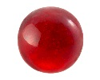
PathStore
Cloud
Marbels Table
Core 1
Core 2
select * from marbles
Marbels Table
Marbels Table
select * from marbles
where color = blue
Edge 1
Edge 2
Edge 3
Marbels Table
Marbels Table
Marbels Table
select * from marbles
select * from marbles where color = green
select * from marbles where color = blue

Slide 34
PathStore
Cloud
Marbels Table
Core 1
Core 2
select * from marbles
Marbels Table
Marbels Table
select * from marbles
where color = blue
Edge 1
Edge 2
Edge 3
Marbels Table
Marbels Table
Marbels Table
select * from marbles
select * from marbles where color = green
select * from marbles where color = blue

Slide 35
PathStore
Cloud
Marbels Table
Core 1
Core 2
select * from marbles
Marbels Table
Marbels Table
select * from marbles
where color = blue
Edge 1
Edge 2
Edge 3
Marbels Table
Marbels Table
Marbels Table
select * from marbles
select * from marbles where color = green
select * from marbles where color = blue

Slide 36
PathStore
Cloud
Marbels Table
Core 1
Core 2
select * from marbles
Marbels Table
Marbels Table
select * from marbles
where color = blue
Edge 1
Edge 2
Edge 3
Marbels Table
Marbels Table
Marbels Table
select * from marbles
select * from marbles where color = green
select * from marbles where color = blue

Slide 37
PathStore
Cloud
Marbels Table
Core 1
Core 2
select * from marbles
Marbels Table
Marbels Table
select * from marbles
where color = blue
Edge 1
Edge 2
Edge 3
Marbels Table
Marbels Table
Marbels Table
select * from marbles
select * from marbles where color = green
select * from marbles where color = blue

Slide 38
PathExecute
Common execution environment
Serverless model
Stateless function running inside a container
Application consists:
Java Servlets
Common Java libraries, e.g., OpenCV
Statically linked binary (accessed over JNI)
Stored on PathStore
Container/JVM reused across invocations
Can cache state in memory and local file system (/tmp)
Stateless
Container may be reclaimed at any time
Can leverage state caching, but should not rely on it
Persistent state stored on PathStore

Slide 39
Evaluation: Test-Cases
Microbenchmarks
Face detection
OpenCV
Face recognition
OpenCV
IoTStat aggregator

Slide 40
Evaluation: Topology
Notes:
Wenlu Hu, Ying Gao, Kiryong Ha, Junjue Wang, Brandon Amos, Zhuo Chen,
Padmanabhan Pillai, and Mahadev Satyanarayanan. 2016. Quantifying the impact
of edge computing on mobile applications. In Proceedings of the 7th ACM SIGOPS
Asia-Pacific Workshop on Systems. ACM, 5.

Slide 41
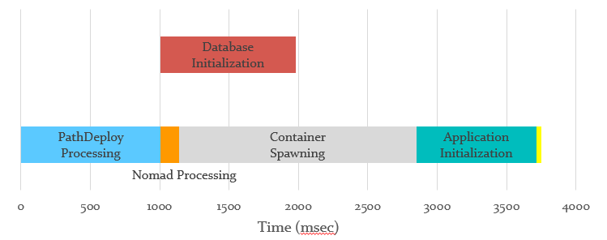
Application Deployment Time
HelloWorld Application deployed on the edge node
Downloading and deploying a minimal container (only JVM) from a cloud location is 13.2 seconds

Slide 42
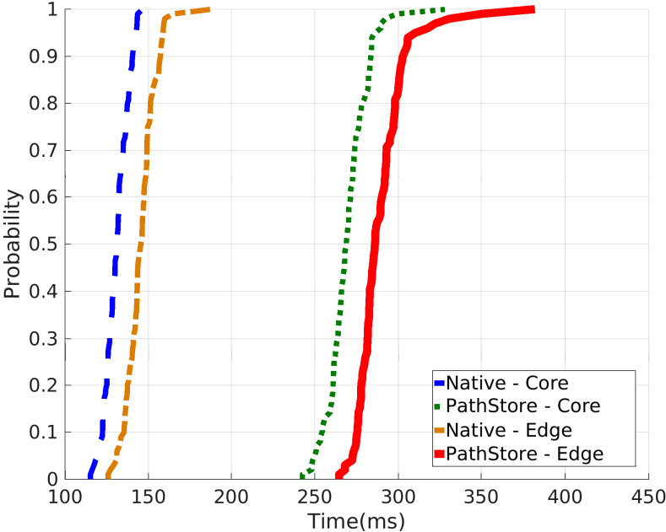
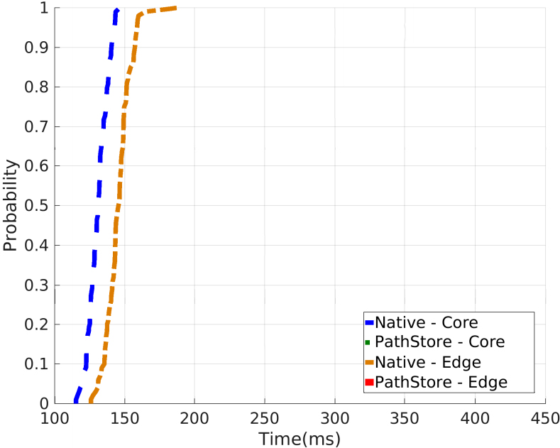
PathStore Read Miss

Slide 43
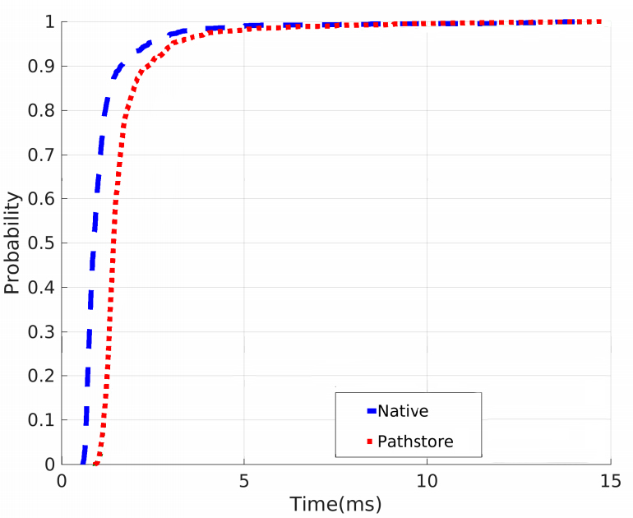
PathStore Read Hit

Slide 44
Data Propagation Time
82.8 ms
263.6 ms
Cloud
Core1
Core2
37 ms
9.8 ms
Edge1
Edge2
Edge3

Slide 45
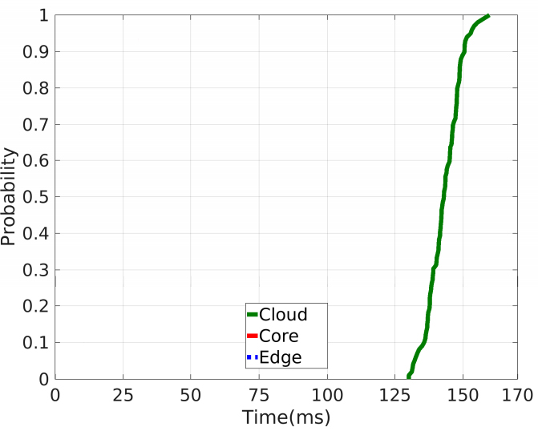
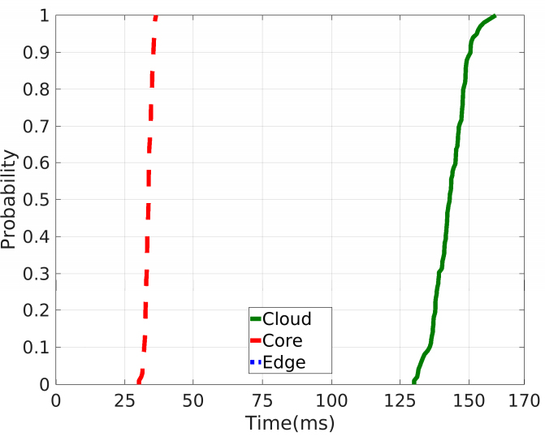
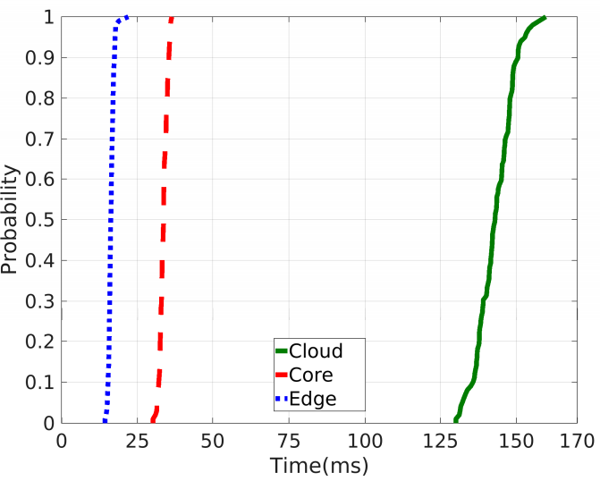
Face Recognition

Slide 46
Conclusion
Path computing
a new paradigm that enables processing and storage on a progression of datacenters interposed along the geographical span of the network
CloudPath, a new platform that implements the path computing paradigm
Eventual consistent storage service that automatically replicates application state on-demand across the multiple datacenter tiers
Deploys applications that are consisted of short-lived and stateless functions and can be rapidly instantiated on-demand
Fast
Easy to program

Slide 47
Future work
Improved support for user mobility
Additional consistency models
Disconnected operation
Streaming, multi stage data reduction
More applications

Slide 48
Questions
48

