Slide 1
Octopus: Efficient Data Intensive Computing on Virtualized Environments
Svitlana Tumanova*, Olga Irzak*, Lili Sun*†,
Shiri Margel*, and Eyal de Lara*
* University of Toronto † University of Science and Technology Beijing

Slide 2
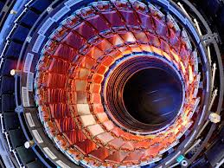
HPC in Virtualized Data Centers
Computations are moving to big data
Big data generators (eg Large Hadron Collider) host data in their own data centers (EGEE) to avoid costly data movement and provide access to large number of researchers
Large data center providers host public datasets, allowing researchers to run analysis and computations against them:
Providers: Amazon, Microsoft, Google
Datasets: bioinformatics, astronomy, social data
Computations in those data centers often run in virtualized environments
Advantages: security, performance isolation, ease of management

Slide 3
Problem: Lack of Sharing
Researcher 1
Researcher 2
Application
Application
File
File
VM
VM
VMM
File Server

Slide 4
Our solution: Octopus Framework
Researcher 1
Researcher 2
Application
Application
Scheduler
VM
VM
File
A
B
A
B
VMM
File Server
B
B
A
A
B
A

Slide 5
Octopus-FS
1. NFS server
2. Buffer Cache
3. Shared Buffer Cache
VM
VM
VM
VM
VM
VM
File
File
File
File
fetch
copy
File
File
NFS Server
map
File
File
VMM
VMM
VMM
read bandwidth:
91-94 MB/s
pros: no double network fetches
cons: very slow
read bandwidth:
825-845 MB/s
pros: much faster
cons:
copying
private copies
within VM
read bandwidth:
8533 – 9630 MB/s
pros:
no copying
extra memory for VMs
cons: read-only access

Slide 6
Octopus-FS Architecture
Physical Host
DomU
Dom0
File Server
File
Cache
File
Hypervisor

Slide 7
Octopus-Scheduler
Scheduler
Launch application
to place file
Octopus-FS
Evict file
Octopus-Scheduler performs 3 functions:
manages the allocation of files to caches,
selects the next job to run and launches it, and
determines whether an application will access its data over OFS or use network file system

Slide 8
Scheduling Algorithms
Objective: minimize network transfer and queue runtime
B
B
A
A
A
A
B
B
A
B
File A: ½; File B: ½
Cluster Allocation: (½, ½)
Fair share: allocation of files in the cluster based on current state and future demand.
Algorithm: maintain current file allocation as close as possible to fair share allocation.

Slide 9
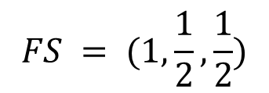
Fair Share Algorithm
C
A
Machine 1
Machine 2
A
B
A
C
A C
B
B A
B C
File’s fair share:
$FS\left(A\right)= \frac{\left(1 + 1\right) × 1}{4}$ x 2 = 1; $FS\left(B\right)=\frac{1}{2};FS\left(C\right)=\frac{1}{2}$
$$FS = (1,\frac{1}{2},\frac{1}{2})$$
Fair share allocation:
Current share allocation:
$$CSA=(2, 1, 1),$$
$$CSC=(1, 1, 2)$$
Difference of current & fair share allocations:
$$DiffA=1.5,$$
$$DiffC=2.5$$
→ Launch job using file A on the machine

Slide 10
In-House Cluster Setup
12 Sun Fire x2250s (8 cores, 16GB RAM) connected on 1 Gigabit Ethernet link
10 computational nodes (7 VMs, 3.5 GB cache)
1 Scheduler, 1 File Server node
Bioinformatics applications: BLAT, FASTA, FSA-Blast, Ssearch, and Tandem Repeats
Queue: 910 jobs, skewed distribution ABA, limited visibility: 1/3 of queue, max skip allowed: 105 times
Data: public genomes, size 150 MB to 3.5 GB, total: 51 GB

Slide 11
Benefit of caching
Pure-OFS sends 83% less data than NFS and incurs 47.5% reduction in runtime

Slide 12
Benefit of NFS-fallback
OFS+NFS reduces runtime by 6%, and increases network transfer by 24% compared to pure-OFS

Slide 13
Amazon EC2 Cluster Setup
Emulation:
Physical machine -> EC2 VM instance
OFS -> RAMFS
EC2 instances of type High Memory Quadruple Extra Large with 8 vCPUs, 68.4GB memory and High I/O
Applications:
Bio-informatics: FASTA
Natural language processing: Artist Recognition (training & testing)
Data: 8.5GB and 11GB data sets, total size: 456GB

Slide 14
Worst and Good-Case Scenarios
In both, worst- (uniform) and good- (A) cases, network traffic reductions are significant (64% and 75%)

Slide 15
Dynamic Popularity Adjustment
Octopus adapts effectively to the changing file popularity.

Slide 16
Conclusions and Future Work
Octopus – a framework for running data-intensive applications on virtualized environments
Octopus-FS – enables sharing of files between VMs within physical host
Octopus-Scheduler – performs data-local application placement and popularity-proportional file distribution
Octopus reduces network traffic by up to 83% and queue run time by up to 55%
Future work:
Trade-off between using memory for cache and for computations,
Gang scheduling.

Slide 17
Q&A

Slide 19
Backup Slides

Slide 20
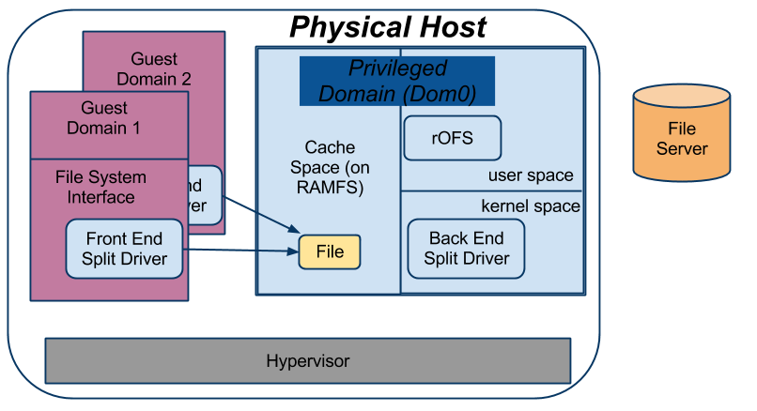
Octopus-FS

Slide 21
Scheduling Algorithms Details
Main idea: allocate files in the data center according to their fair share
Also explored:
frequency of recalculation: eager vs lazy
job selection policies: size, queue, and runtime

