Slide 1
The Case for Energy-Oriented Partial Desktop Migration
Nilton Bila, Eyal de Lara University of Toronto
Matti Hiltunen, Kaustubh Joshi, H. Andres Lagar-Cavilla AT&T Labs Research
Mohadev Satyanarayanan
Cargie-Mellon University

Slide 2
Problem
Offices & homes crowded with desktop PCs
PCs idle on average 12 hours a day (Nedevschi09)
60% of desktops remain powered overnight (Webber06)
Why do we care?
Dell Optiplex 745 Desktop Peak power: 280W Idle power: 102.1W Sleep power: 1.2W
Notes:
-the reasoning behind our approach is...

Slide 3
Why Idle Desktops Stay On?
Always-on semantics
Background Applications: IM, E-mail, VoIP
Remote Access: files, remote admin

Slide 4
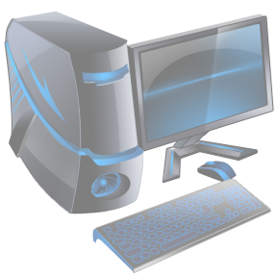
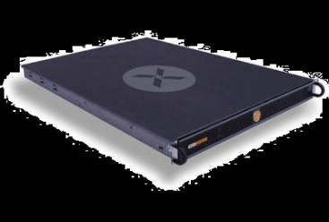
Full VM Migration
Encapsulate user session in VM
When idle, migrate VM to consolidation server and power down PC.
When busy, migrate back to user’s PC

Slide 5
Full VM Migration
Encapsulate user session in VM
When idle, migrate VM to consolidation server and power down PC.
When busy, migrate back to user’s PC
Downside: VMs are large

Slide 6
Partial VM Migration
Insight: Idle VM access only a small fraction of their memory and disk state
Migrate just the working set

Slide 7
Advantages
Small migration footprint
Client
Fast migration
Low energy cost
Network
Gentle on network resources
Server
High consolidation ratios

Slide 8
Advantages
Small migration footprint
Client
Fast migration over 3G or WiFi
Low energy cost mobile devices
Network
Gentle on network resources
Server
High consolidation ratios

Slide 9
Advantages
Small migration footprint
Client
Fast migration over 3G or WiFi
Low energy cost mobile devices
Network
Gentle on network resources wide area (IaaS)
Server
High consolidation ratios

Slide 10
Research Questions
Length of sleep times?
Size of the memory footprint?
Prototyped simple on-demand migration approach with SnowFlock
Monitor memory and disk page migration to clone VM

Slide 11
Setup
Dell Optiplex 745 Desktop
4GB RAM, 2.66GHz Intel C2D
Peak power: 280W
Idle power: 102.1W
Sleep power: 1.2W
VM Image:
Debian Linux 5
1GB RAM
12 GB disk

Slide 12
Workloads
Workload | Description
Login | The login screen of a Linux desktop system (GDM).
E-mail | Mozilla thunderbird connected to an IMAP e-mail server. The client polls the server every 10 minutes.
IM | The Pidgin multi-protocol IM client connected to an IRC room with more than 100 users.
Multitask | A Gnome Desktop session with the E-mail client, IM client, Spreadsheet (OpenOffice Calc), PDF Reader (Evince) and file browser (Nautilus)

Slide 13
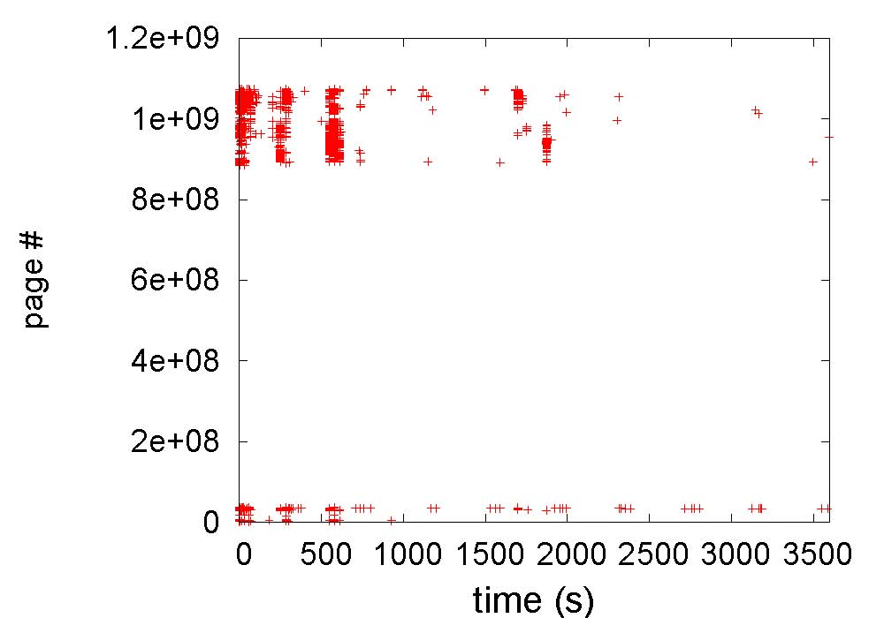
Memory Request Pattern
Spatial locality
Potential benefits for pre-fetching
Migration Pattern: E-mail
Notes:
Application code & data, and kernel data on top
Kernel code on the bottom

Slide 14
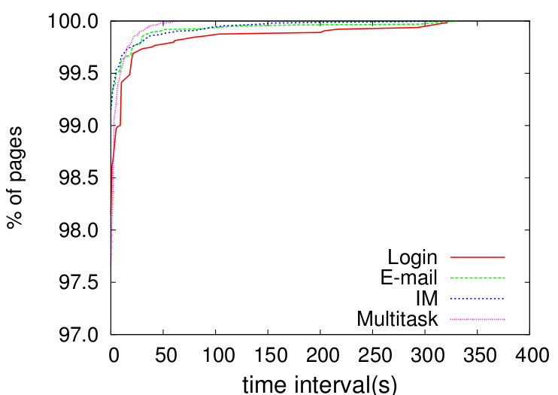
Page Request Interval
98% of request arrive in close succession
Migration Pattern: E-mail
Notes:
Application code & data, and kernel data on top
Kernel code on the bottom

Slide 15
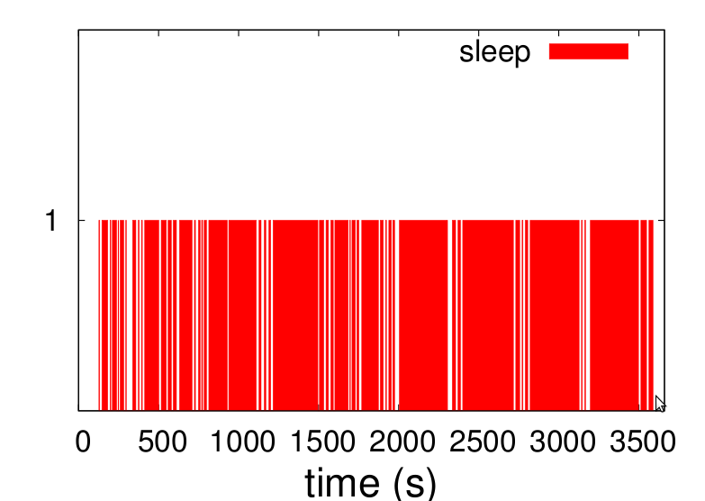
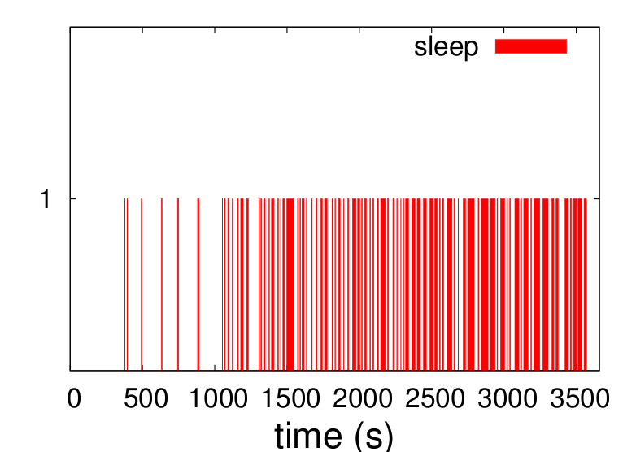
Sleep Potential
Total sleep of 17 to 46 minutes out of 1hour
Energy savings of 50% to 0.
Sleep opportunities increase over time
Email
Multitask
E-mail
Multitask
Notes:
The page request frequency is high at first, but decreases over time (as the working set stabilizes) creating more opportunities for sleep.

Slide 16
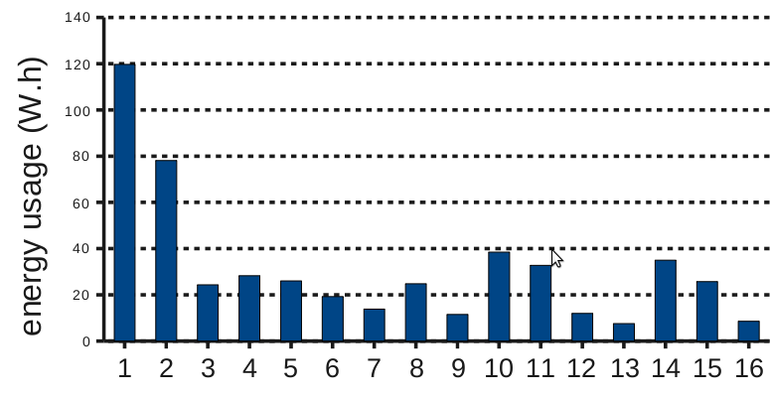
Energy Savings: Overnight
Inefficient in 1st hour
69% energy savings overall

Slide 17
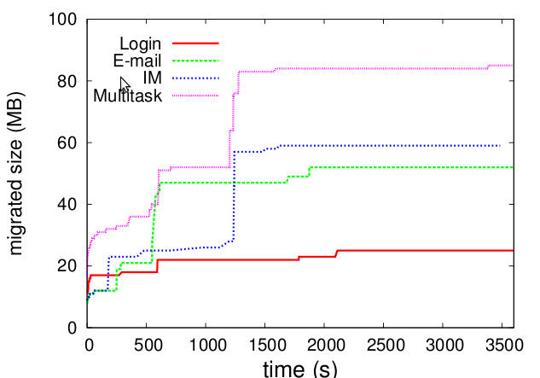
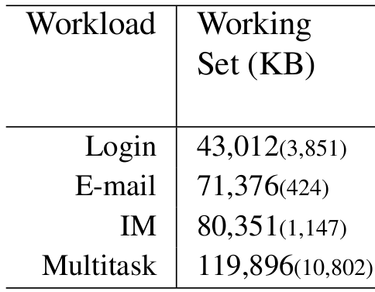
Memory Footprint
A cloud node with 4GB of RAM can run ~30 VMs
Notes:
Memory footprint stabilizes after 25 minutes.
Working set likely unaffected by RAM allocation. For example, experiments with 512 MB RAM yielded similar results to the current 1 GB allocation.

Slide 18
Open Challenges
Frequent power cycling reduces hw life expectancy and limits power savings
Reduce number of sleep cycles and increase sleep duration
Predict page access patterns and prefetch
Leverage content addressable memory
Fast reintegration
Policies
When to migrate/re-integrate?
When does the desktop go to sleep?
On re-integration, should state be maintained in the cloud? For how long?

Slide 19
Related Work
Remote wake up: Wake-on-LAN, Wake-on-Wireless
No support for always-on applications
Short sleep times
Protocol proxy: Nedevschi’09, Reich’10
Limited flexibility
Application proxy: Somniloquy, Turducken, SleepServer
Applications must be modified
Management of applications may be complex
Full VM Migration: LiteGreen
Low consolidation ratios
Bandwidth intensive

Slide 20
Conclusion
Proposed partial VM migration
Even naïve partial VM migration can reduce energy use of idle desktop
32 – 50% over an hour-long idle interval
69% overnight
Idle desktop sessions have a memory footprint an order of magnitude smaller than their RAM allocation.
Partial VM migration can save medium to large size organizations tens to hundreds of thousands of dollars

Slide 21
Thanks!
http://sysweb.cs.toronto.edu/snowflock
delara@cs.toronto.edu
Questions?

Slide 22
Annual Overnight Energy Costs
44% to 60% reduction in energy costs

