Slide 1

CILoS: A CDMA Indoor Localization System
Waqas ur Rehman, Eyal de Lara, Stefan Saroiu
Notes:
- I am going to present CILoS, which is an CDMA based indoor location system and achieves median accuracy of 5 meters.

Slide 2
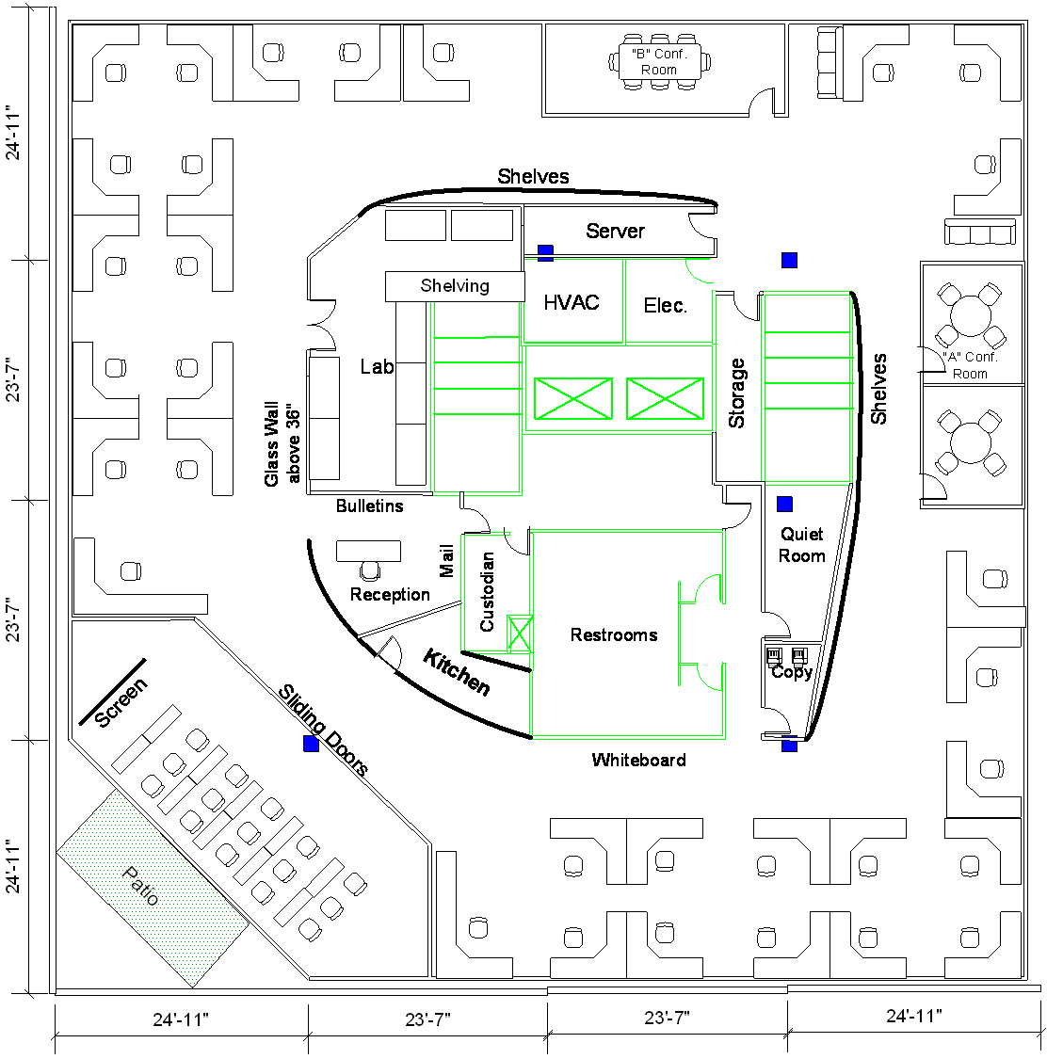
Motivation
People spend most of their time indoors
GPS does not work indoors
Emergency response
Social-Mobile
Navigation
Mobile Games
Advertising
?
?
?
?
?
?
?
?
?
?

Slide 3
Fingerprinting – Building a radio map
AP1: -41
AP2: -54
AP3: -92
AP4: -35
AP5: -64
AP6: -72
AP1: -41
AP2: -54
AP3: -92
Notes:
This is a map of a typical building floor. Circles represent locations were fingerprints were collected. Yellow boxes list APs and the signal strength values as recorded at a specific location. Note that nearby locations have similar fingerprints, while the fingerprints of far locations look different.
Once fingerprints are colleted and stored, the next step would be to perform the localization

Slide 4
Fingerprinting – K Nearest Neighbors
AP1: -40
AP2: -56
AP3: -83
Current Fingerprint
Notes:
Fingerprinting is a good technique that is appropriate and proved to work well with WiFi in indoor environments. The question remains whether we can use GSM fingerprinting to achieve good localization accuracies.

Slide 5
Signal Fingerprinting Approaches
802.11
GSM
CDMA
  Power adaptation to accommodate network load
    High temporal variations in signal strength
  Use signal delay
Signal strength

Slide 6
Signal Strength vs. Signal Delay Variations
Notes:
- We can eliminate these erroneous reading with a two step filtering technique.

Slide 7
CDMA Networks
Base stations share the same spectral bandwidth
Base stations are tightly synchronized with GPS
Base stations cooperate to transmit pilot signal
32768 symbols
64
Notes:
CDMA is a spread spectrum technique in which all the base stations of an operator share the same frequency.
Pilot channel is used at the mobile station to uniquely identify

Slide 8
CDMA Networks
Base stations share the same spectral bandwidth
Base stations are tightly synchronized with GPS
Base stations cooperate to transmit pilot signal
PN offset
Key idea: Fingerprint PN offsets
Notes:
CDMA is a spread spectrum technique in which all the base stations of an operator share the same frequency.
Pilot channel is used at the mobile station to uniquely identify

Slide 9
Data Collection
Condor CDMA scanner
Recorded signal delay and strength over all channels in
  Downtown
  Suburb
6 channels in downtown
4 channels in suburb
Notes:
- These buildings are located in different geographical regions that widely differ in their network coverage characteristics.

Slide 10
Average Visible PNs
Interference limits # of visible base stations
Wide fingerprints require scanning multiple frequency bands
Notes:
- We can eliminate these erroneous reading with a two step filtering technique.

Slide 11
Localization Algorithms
Simple Algorithms
  1 Channel
  All Channel
Feature Selection Algorithms
Notes:
That differ in the number of channels used in localization
Some of the sources are noisy

Slide 12
Localization Error
Wide fingerprints help
Careful PN selection critical
Notes:
- We can eliminate these erroneous reading with a two step filtering technique.

Slide 13
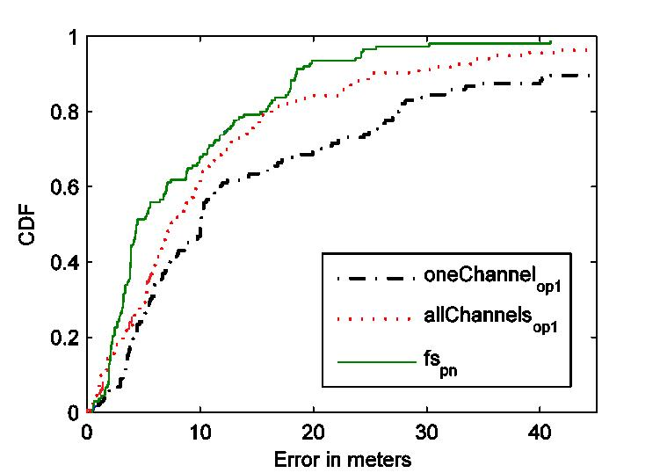
Localization Error CDF (Downtown)
Notes:
- We can eliminate these erroneous reading with a two step filtering technique.

Slide 14
Comparison with WiFi and GSM
Notes:
- We can eliminate these erroneous reading with a two step filtering technique.

Slide 15
Floor Level Localization
Notes:
- We can eliminate these erroneous reading with a two step filtering technique.

Slide 16
Conclusions
Signal delay is a reliable metric for fingerprinting
  Temporal stability
  Spatial variability
CILoS achieves median accuracy of 5 meters
Wide signal fingerprints critical to accuracy
Feature selection really helps

Slide 17
Future Works
Get it to work on commodity cell phone
Requires
  Access to PN offsets
  Scan multiple frequency bands

Slide 18
Question?
delara@cs.toronto.edu
www.cs.toronto.edu/~delara

